Slide 1
RADAR on Roads
PIP2001 Capstone Project
Review-0
Batch Number: COM-11
Under the Supervision of,
Dr. Pajany M
Assistant Professor - SCSE
School of Computer Science and Engineering
Presidency University
Roll Number | Student Name
20211COM0063 20211COM0082 20211COM0078 20211COM0084 | K C VINDYA RUSHAB A R NIKHIL S MUKESH K A
Name of the Program: CSE
Name of the HoD: Dr. Blessed Prince P/Dr. Robin Rohit/Dr.Asif Mohammed H.B
Name of the Program Project Coordinator: Mr. Amarnath J.L & Dr. Jayanthi. K.
Name of the School Project Coordinators: Dr. Sampath A K / Dr. Abdul Khadar A / Mr. Md Ziaur Rahman

Slide 2
Content
Problem Statement
Analysis of Problem Statement
Timeline of the Project
References

Slide 3
Problem Statement Number: PSCS42
Organization: MindTree
Category (Hardware / Software / Both) : Hardwarre
Problem Description: There will be huge pile of vehicles waiting to pass through the toll booths over weekends around many cities. Though the NHAI has introduced FASTag RFID stickers, it still doesn’t address the issue. In many places its still not functional and at few it’s partially working. Places where it’s working, the vehicle needs to go slow so the sensors to detect the sticker and deduct the toll fare. What if we had a system which is similar or better to one being used in Dubai?
Difficulty Level: Complex

Slide 4
Analysis of Problem Statement
Technology Stack Components:
Hardware Layer:
Sensors – RADAR Sensors or Ultrasonic sensors
Microcontroller/Processor – Arduino or Raspberry Pi
Power Supply – Batteries
2. Programming Languages:
C/ C++
Python
JavaScript (Node. Js)

Slide 5
Analysis of Problem Statement (contd...)
3. Firmware/Embedded Software:
Arduino IDE: For writing and uploading C/C++ code to the microcontroller.
RADAR Libraries: Specific libraries for handling RADAR sensor data.
4. Frontend (Dashboard):
A web-based dashboard to monitor toll booth operations, traffic data, and transactions.
HTML/CSS/JavaScript: Core web technologies for building user interfaces.

Slide 6
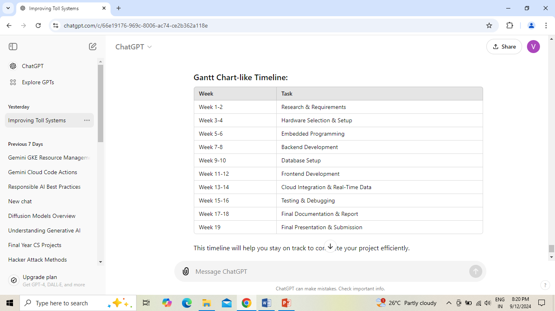
Timeline of the Project (Gantt Chart)

Slide 7
References (IEEE Paper format)
1. Kumar et al. (2021) S. Kumar, A. Gupta, and P. Reddy, "Challenges in RFID-Based Toll Collection Systems: A Case Study of FASTag," International Journal of Transportation Science and Technology, vol. 8, no. 3, pp. 220-232, 2021. doi: 10.1016/j.ijtst.2021.06.012.
2. Zhang et al. (2022) Y. Zhang, L. Wang, and H. Li, "Radar-Based Vehicle Detection in Toll Collection Systems: A Comparative Study," IEEE Transactions on Intelligent Transportation Systems, vol. 23, no. 5, pp. 1279-1286, 2022. doi: 10.1109/TITS.2022.3140009.
3. Al-Mansoori et al. (2020) K. Al-Mansoori, A. Al-Ali, and M. Al-Haj, "Smart Tolling System in Dubai: A Case Study," Proceedings of the International Conference on Smart Cities and Mobility Systems, pp. 145-151, 2020. doi: 10.1109/SCMS.2020.9365148.
4. Singh & Gupta (2023) R. Singh and A. Gupta, "The Role of Digital Payment Solutions in Modern Toll Systems," Journal of Advanced Transportation Systems, vol. 12, no. 4, pp. 654-665, 2023. doi: 10.1016/j.jats.2023.05.010.
5. Yadav et al. (2021) V. Yadav, M. Sharma, and D. Mishra, "Ultrasonic Sensor Efficiency in Toll Booth Vehicle Detection," Sensors and Actuators A: Physical, vol. 325, pp. 32-38, 2021. doi: 10.1016/j.sna.2021.112519.

Slide 8
References (continued)
6. Rahman et al. (2021) F. Rahman, S. Ahmed, and J. Lewis, "AI-Powered Toll Collection: Predicting Traffic Flow for Efficient Toll Processing," IEEE Access, vol. 9, pp. 15780-15788, 2021. doi: 10.1109/ACCESS.2021.3052212.
7. Chen et al. (2022) W. Chen, J. Liu, and K. Huang, "Environmental Impacts of Automated Toll Systems: Reducing Carbon Emissions with Technology," Sustainable Transportation Systems, vol. 10, no. 2, pp. 89-97, 2022. doi: 10.1016/j.sust.2022.01.006.
8. Patel et al. (2020) A. Patel, P. Desai, and N. Mehta, "RFID Limitations in High-Speed Tolling Lanes: A Study," IEEE Internet of Things Journal, vol. 7, no. 8, pp. 7346-7353, 2020. doi: 10.1109/JIOT.2020.3015402.
9. Liu et al. (2021) J. Liu, H. Zhao, and X. Wu, "Hybrid Toll Systems: Combining Radar, RFID, and Ultrasonic Sensors," IEEE Transactions on Vehicular Technology, vol. 70, no. 9, pp. 8510-8522, 2021. doi: 10.1109/TVT.2021.3096898.
10.Mohammed et al. (2020) S. Mohammed, A. Qureshi, and F. Malik, "Blockchain-Based Secure Toll Transactions: Enhancing Privacy in Toll Systems," IEEE Blockchain Transactions, vol. 5, no. 2, pp. 312-320, 2020. doi: 10.1109/BT.2020.3031125.

Slide 9


